Slide 1

FINAL PROJECT PURWADHIKA
BANK TELEMARKETING ANALYSIS AND CLASSIFICATION
Fadhlilah Faiz Ulwan/JCAH BANDUNG

Slide 2

Bank Telemarketing Dataset
Last update : 2020
Uploader : Volodymyr Gavrysh
Usability : 10.0
Introduction
It is a dataset that describing Portugal bank marketing campaigns results.
Conducted campaigns were based mostly on direct phone calls, offering bank client to place a term deposit.
Problem Statement
Banco de Portugal is one of national bank of portugal. During this pandemic, a financial industry is the one of most affected sector and it make the Board of the Bank want to do restructuring the campaign system to make more efficient in terms of budget and time.
1. Find a potential customer/client in the middle of covid-19 crisis.
2. Consider about the tight cash and time, Banco de Portugal does not want to spend money (campaign cost) and time on non-potential customer/client.

Slide 3
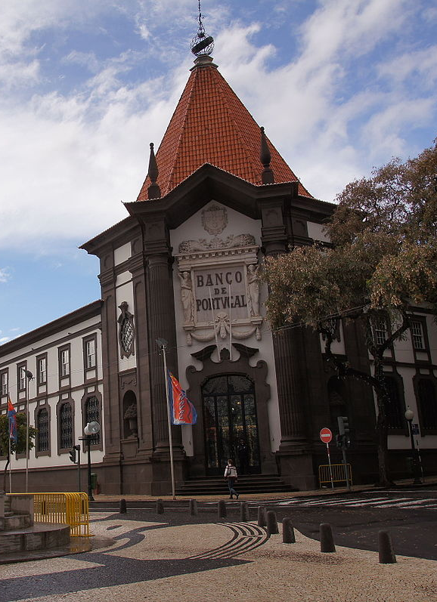
Highlights to my project
Project
Bank Telemarketing Analysis and Classifications Study Case : Banco de Portugal
Machine Learning
Classification
Objective
The classification goal is to predict if the client will subscribe a term deposit or not
Remarks
Learn about EDA and classification machine learning system.

Slide 4


















Problems
Subscription Predictor Searching the best modelling that possible to predict the decision of the customer..
Machine Learning Apply machine learning to data with classification modelling
Explore Data
Do EDA for subscription status
Satements
Company wants to restructuring the campaign system. Company wants to make an efficient budget and time during .this campaign
Problems
Solutions

Slide 5



Modelling Strategy
MODELING SUCCESS AND DEPLOYMENT
Adjusting Threshold
Hyperparameter Tuning
Find best precison score with Hyperparameter tuning
Classification Modelling
Train data with each feature engineering method
and do classification modelling
Classification Modelling
Train original data with default classification modelling (Logistic Regression, Kneighbors, Random Foresest, DecisionTree.
Feature Engineering
Scalling
Ecoding
Polynomial
SMOTE, RUS
Selection Features
EDA
Handling missing value
Drop unnecessary feature
Data Visualization

Slide 6
Conclussion
We got 71% on Precision score
Threshold = 0,61
We have an issue with imbalanced method. This data couldn’t receive for any imbalanced method such as SMOTE, RUS, and Nearmiss. The modell could be better than before if we adding new data that have ‘yes’ in subscription
=> weight on Logistic Regression

